Slide 1
Mental set – what we have learn so far
3x(4dx + 7h)
4d + 8hg – 6d =
5x (7aw – 9x)
7y – 6ey + 8y – 14ye =
(x – 3)(x + 5) =
(x – 7 (x – 4) =
Notes:
hook

Slide 2

Lesson objective
By the end of this lesson you will be able to;
- Find common factors and factorise equations.
Notes:
Lesson

Slide 3
24
7
30
Date
Factorisation
EQ – How do I factorise equations?
What is Factorisation?
What are common factors?
Factorisation is the process of moving an equation into brackets. This is done by placing the common factors of the equation on the outside of the bracket.
Factors are the numbers you multiply together to get another number. Common factors are common in two separate numbers. Example: 12 and 30 • The factors of 12 are: 1, 2, 3, 4, 6 and 12 • The factors of 30 are: 1, 2, 3, 5, 6, 10, 15 and 30 So the common factors of 12 and 30 are: 1, 2, 3 and 6
5
Notes:
Input

Slide 4
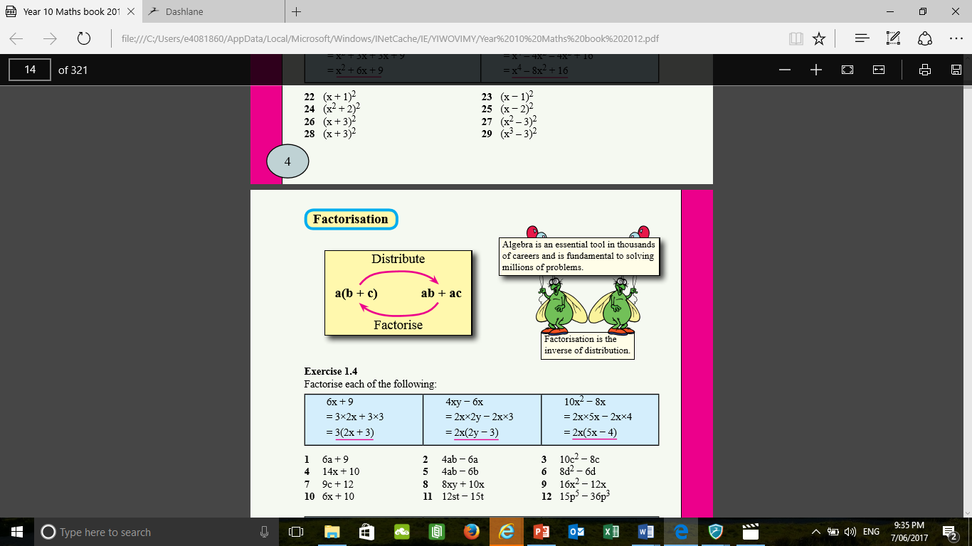
24
7
30
Date
Factorisation
EQ –How do I factorise equations?
What are the steps of factorisation?
Find the common factors within the equation.
18xy + 30y (2, 3, 6, y)
If letters are present in both terms they are also common factors.
2. Choose the Highest Common factor (HCF) and any common letters and place them on the outside of the bracket.
6y (
3. We need to think of a number and letters that we can multiply 6y by to get it back to 18xy? 6y x 3x =18xy
6y ( 3x
4. We need to think of a number and letters that we can multiply 6y by to get it back to 30y? 6y x 5= 30y
6y (3x + 5)
5
Notes:
Lesson objective (EQ)

Slide 5
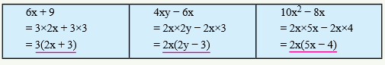
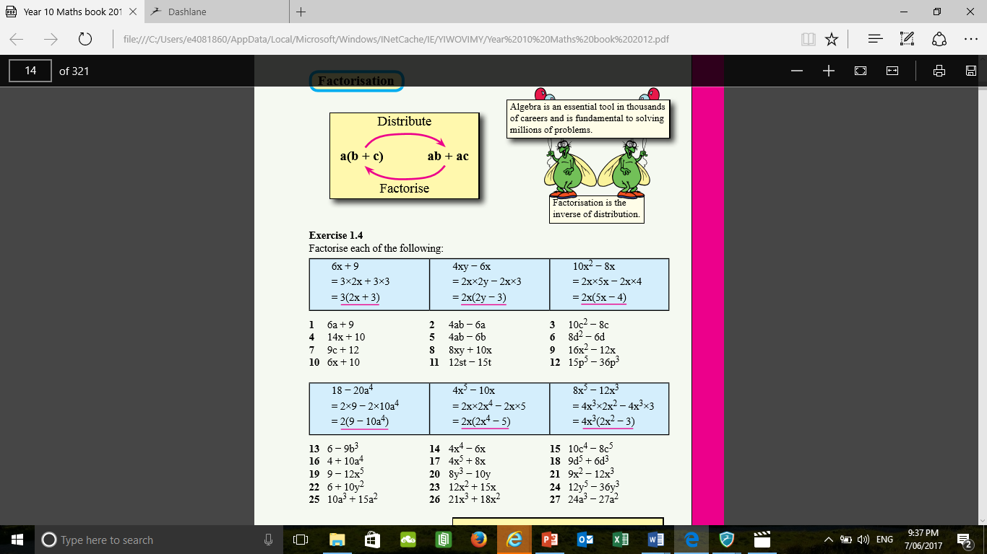
Check for understanding
Notes:
Check for understanding

Slide 6
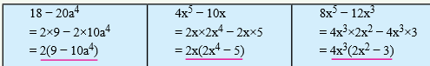

Guided Practice
3kh + 9h
6de – 18hd
24kh$d^{2}$ - 36hd
42$d^{2}$mg + 72md$g^{2}$
Notes:
Guided practice

Slide 7

Activity
Notes:
Independent practice

Slide 8
Closure activity
Please Take a moment Year 10’s and fill in your summaries and answer the EQ in your own words.
How do I factorise equations?
Notes:
Closure

Slide 9


Thankyou Year 10’s and have a wonderful day.
Here is a joke for the road.

